Slide 1
A Look into the Most Prevalent Cause of Death in the United States
Alexa Lutz, Grace Shi, Soumik Sarkar, Alejandro Quintanilla

Slide 2
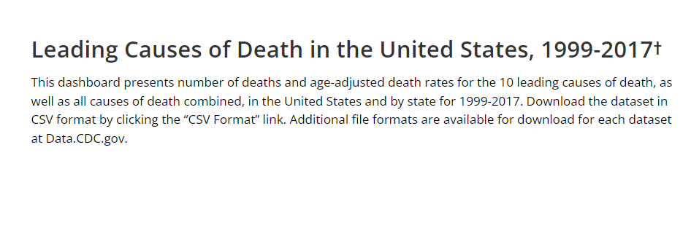

Introduction to Datasets:

Slide 3
Q1: What is the most prevalent cause of death in the US?

Slide 4
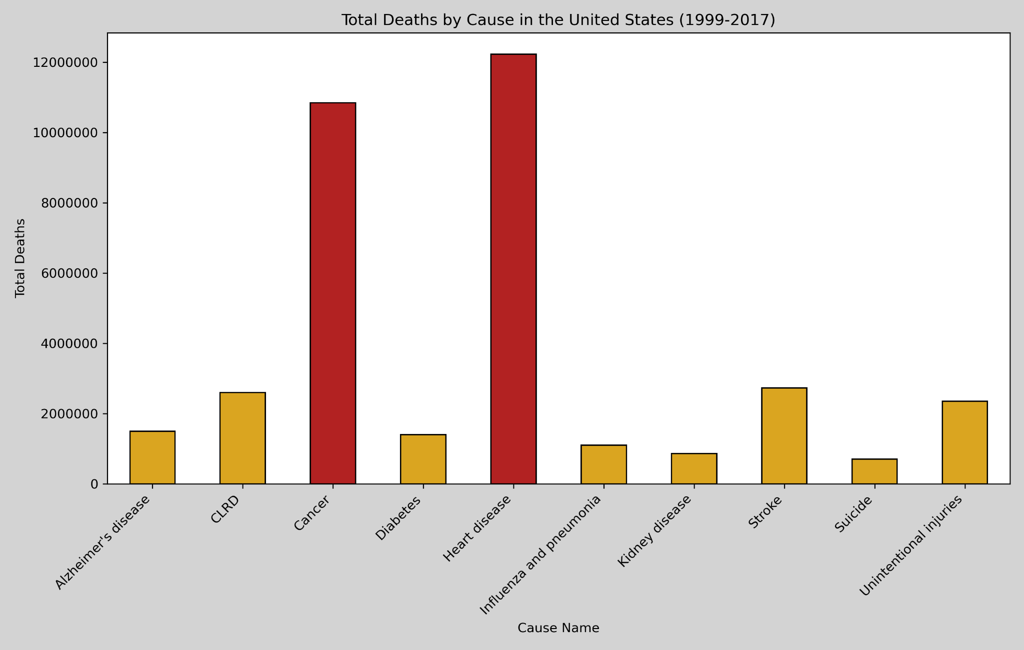
Total Amount of Deaths Over Dataset
Total From Heart Disease - 12,222,640
Total from 2017 - 647,457
Total from Cancer - 10,843,644
Total from 2017 - 599,108

Slide 5
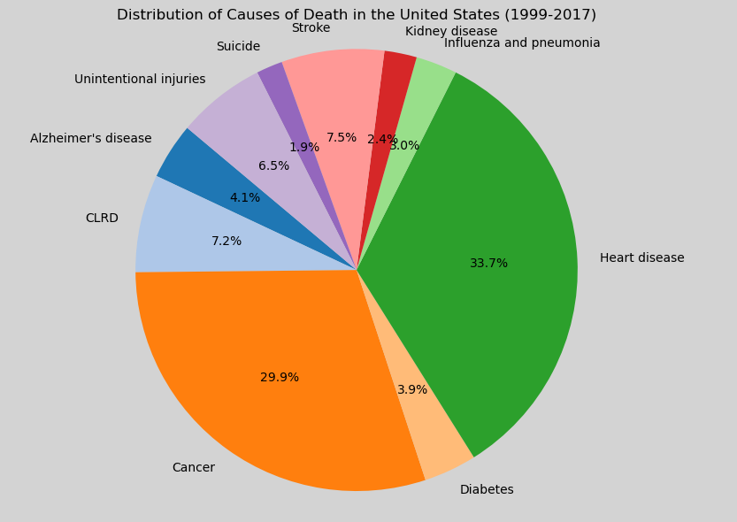
Total Share of Causes of Death

Slide 6
Q2: How have heart disease mortality rates changed over the years?

Slide 7
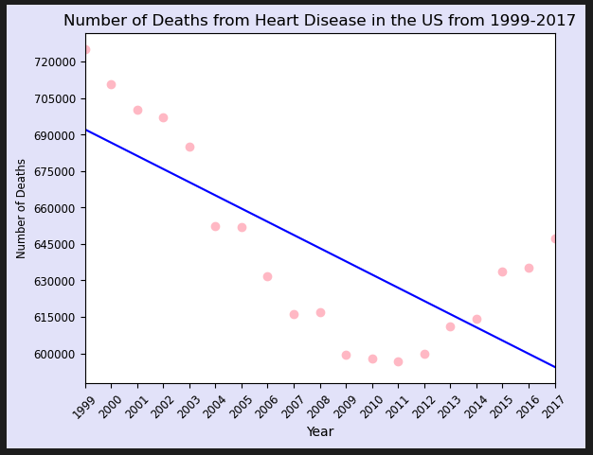
Heart Mortality Rates Across the US
There is a lower mortality rate in 2017 vs 1999
The lowest number of deaths in 2011, the highest number of deaths was in 1999
There was a decrease in deaths from 1999-2011, then an increase of deaths 2012-2017.
Regression line predicts a continuing decrease of mortality rate over time

Slide 8
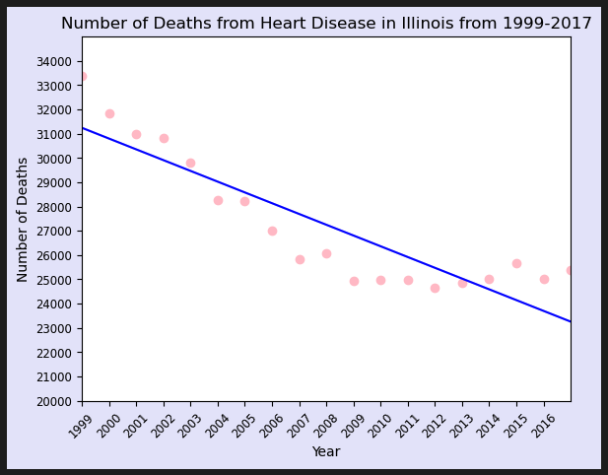
Heart Mortality Rates Across Illinois
There is a lower mortality rate in 2017 vs 1999
The lowest number of deaths in 2009, the highest number of deaths was in 1999
Regression line predicts a continuing decrease of mortality rate over time

Slide 9
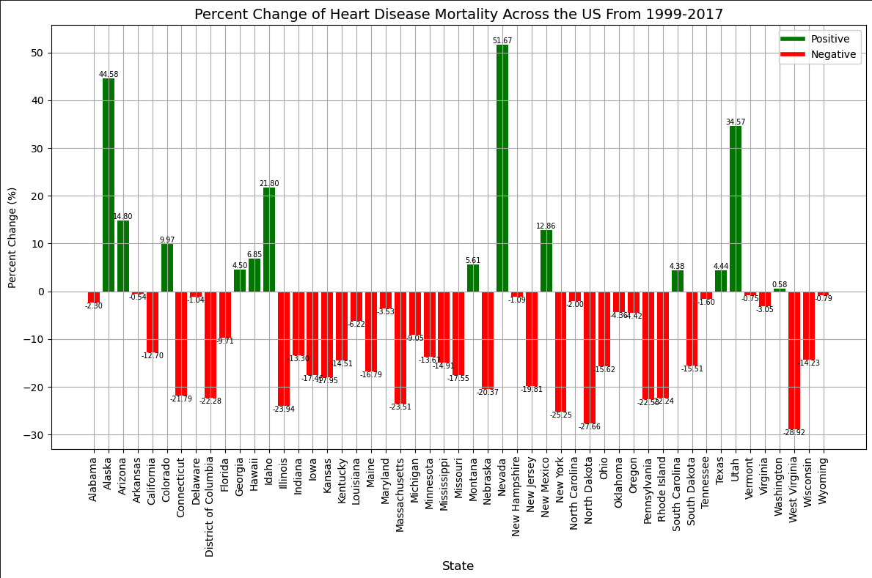
Percent Change of Mortality by State
Out of 50 states, 13 states had a positive increase in Heart Disease Mortality. 37 states had a decrease in heart disease mortality.
Nevada had the highest positive increase of 51.67%
West Virginia had the highest negative increase of -28.92%

Slide 10
Q3: How do mortality rates change based on state?

Slide 11
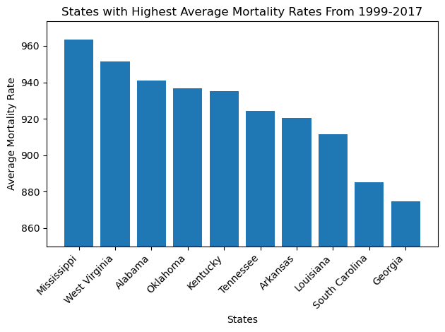
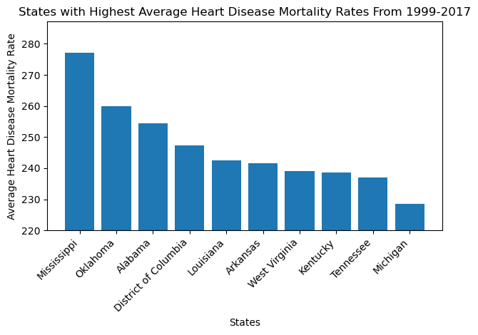
Mean Mortality Rate by State Analysis
“Outliers” are Michigan and DC for Heart Disease
“Outliers” are South Carolina and Georgia for Overall Mortality

Slide 12
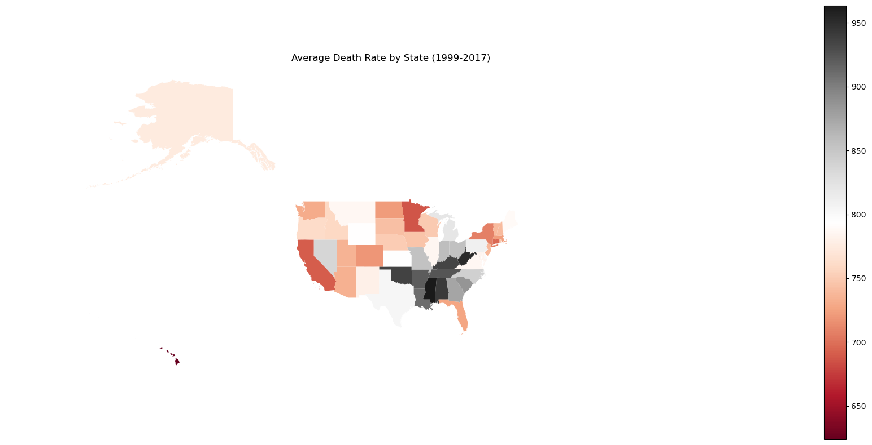
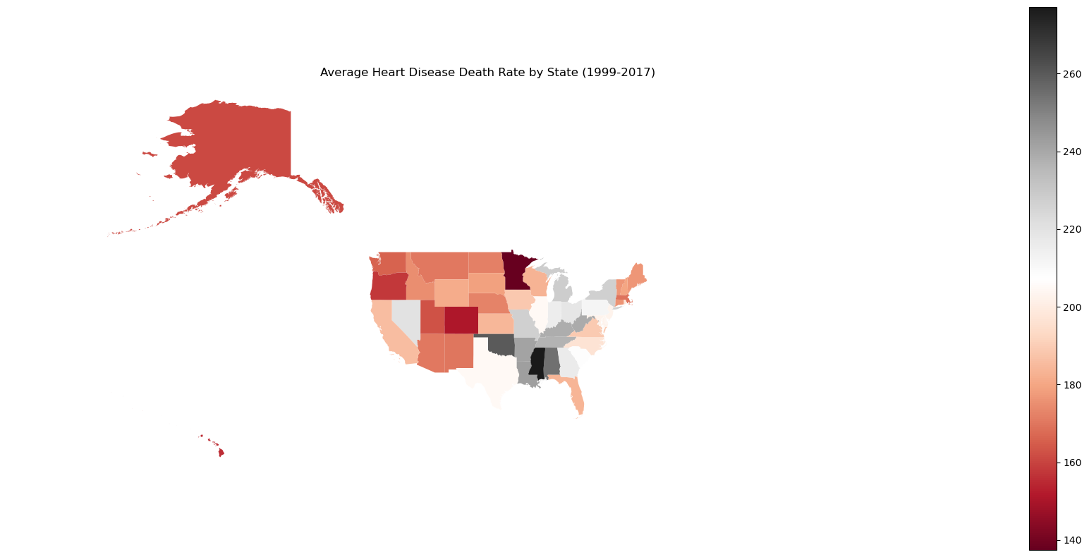
Overall and Heart Disease have similar color schemes
Heart disease is low to the west and very east
Heart Disease appears concentrated in eastern central states

Slide 13
Q4: Are there differences in heart disease mortality rates between genders?

Slide 14
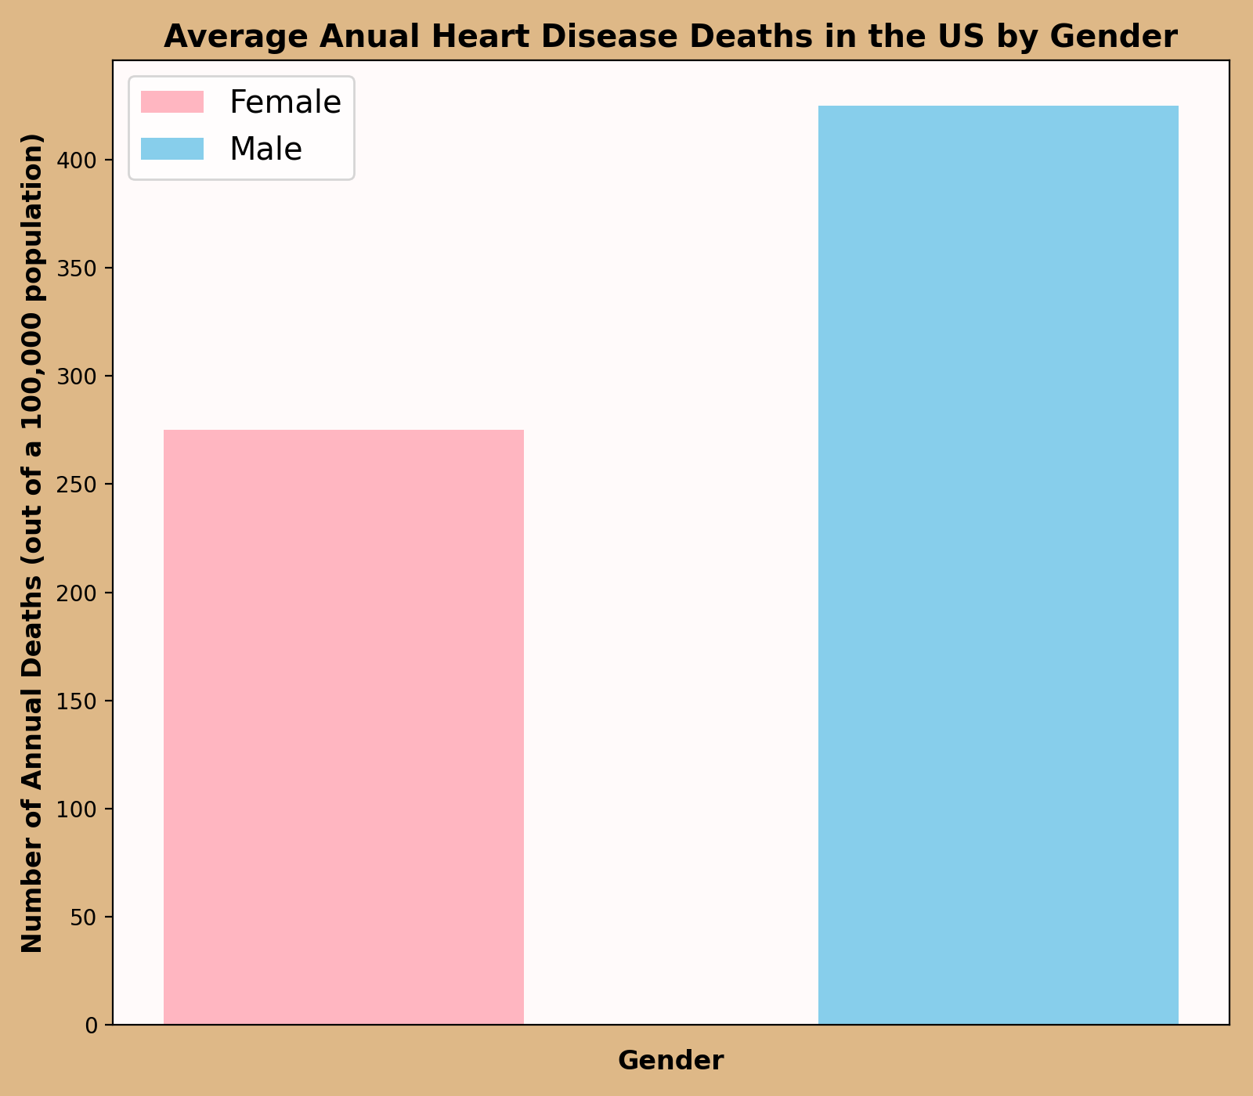
Findings
Average female mortality rate = 275.0/100k (.26%)
STD = 105.9
Average male mortality rate = 424.7/100k (.42%)
STD = 165.3
The male mortality rate is 54% higher to that of the females
Why?
smoking
alcohol
stress adaptability
cholesterol levels
testosterone vs estrogen (and progesterone)
fat distribution

Slide 15
Q4.2: Are there differences in heart disease mortality rates between ethnicities?

Slide 16
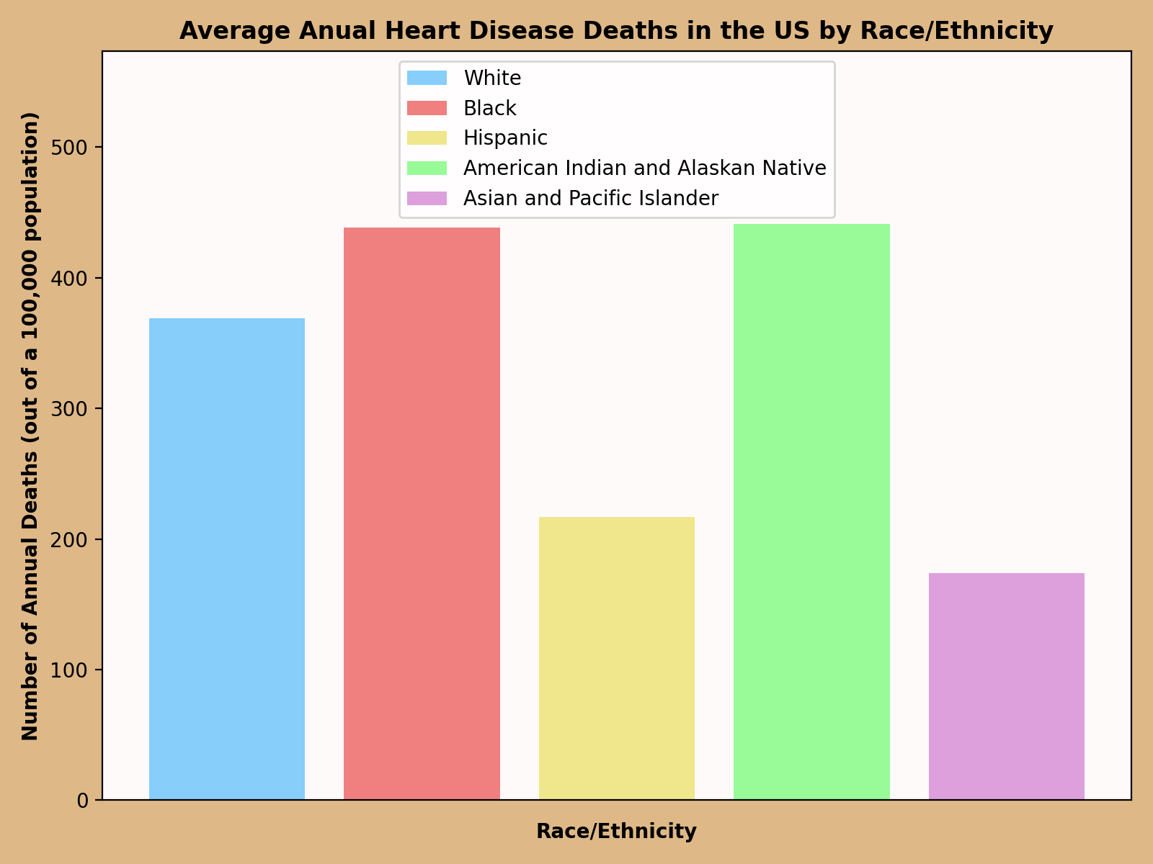
Findings
Average white mortality rate = 369.1/100k ( .37%)
Average black mortality rate = 438.2/100k (.44%)
Average hispanic mortality rate = 216.8/100k (.22%)
Average AIAN mortality rate = 441.2/100k (.44%)
Average API mortality rate = 173.9/100k(.17%)
Both black and AIAN people are >= twice as likely to die from heart disease as API and hispanic people
Why?
poverty/income
available food and exercise
health care
genetics

Slide 17
Citations
https://www.cdc.gov/nchs/products/databriefs/db456.htm#Suggested_citation
disease#:~:text=The%20role%20of%20hormones&text=While%20these%20hormones%20are%20largely,can%20also%20affect%20cardiovascular%20health
https://www.louisianaheart.org/blog/do-men-have-a-higher-risk-for-heart-
https://pubmed.ncbi.nlm.nih.gov/10863872/
https://www.health.harvard.edu/heart-health/race-and-ethnicity-clues-to-your-heart-disease-risk#:~:text=Still%2C%20teasing%20out%20the%20reasons,rates%20seen%20among%20some%20groups.
https://my.clevelandclinic.org/health/articles/23051-ethnicity-and-heart-disease

